Slide 1

Reduction of Teacher MA and The Knowledge Quartet F. Cosgrove cosgrovefh@cardiff.ac.uk

Slide 2
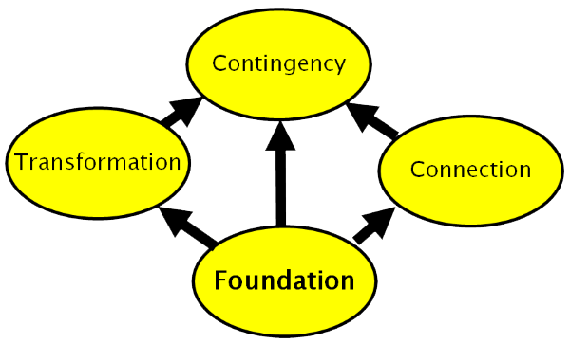
Overview of Research Design & Findings
Introduction to the Knowledge Quartet
Examples
Questions

Slide 3
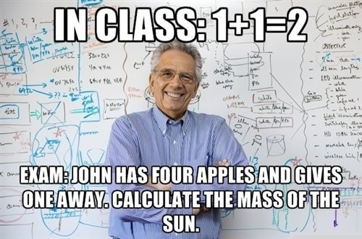
“feelings of tension and anxiety that interfere with the manipulation of numbers and the solving of mathematical problems in ordinary and academic situations” (Richardson and Suinn, 1972, p.551).
Maths Anxiety

Slide 4

Why does teacher MA matter?
Beilock et al. (2010)
17 female primary teachers and their 117 pupils
Teacher MA predicts outcomes for female pupils to a statistically significant (if small) degree.
Schaeffer et al. (2020)
40 primary teachers and their 551 pupils
Findings support the idea that teachers’ maths anxiety is one factor that undermines the learning of both male and female pupils.

Slide 5

A Moment to Breathe
.
Word Cloud representing the most used words in teachers’ reflections

Slide 6
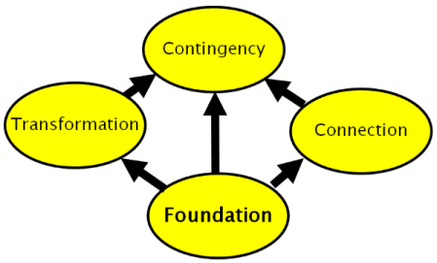
Teacher Professional Development
The Knowledge Quartet: Rowland et al (2005)

Slide 7
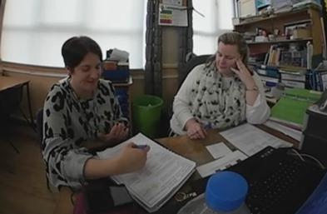
Quantitative Measures
(pre and post)
Maths Anxiety
Hopko et al.
(2003)
General Self Efficacy
Bandura
(Ohio State University, 2017)
Self Efficacy for Maths
Rushton et al. (2016)

Slide 8
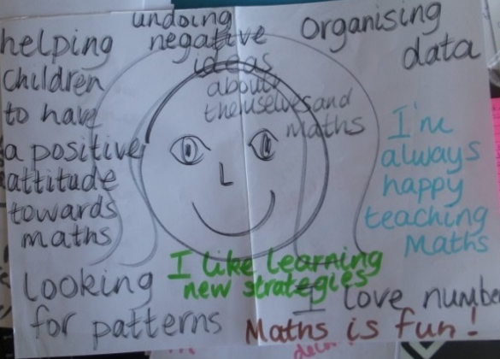
Qualitative Measures
Draw yourself doing maths (pre and post)
Semi structured interviews (pre and post)
Teaching episode recordings
Joint reflection recordings
Teacher and researcher critical incident notes

Slide 9
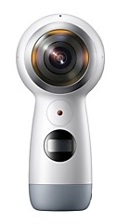
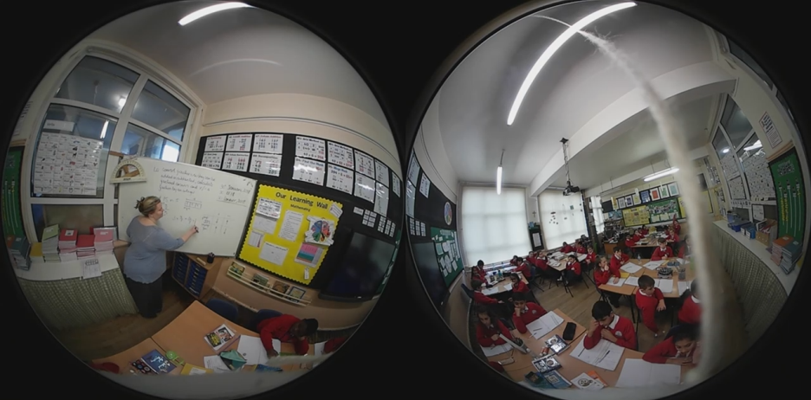
Intervention
Record yourself teaching
Watch the recording and select short critical incidents, reflect on them
Record the timestamp, the KQ code and a comment
Include strengths and opportunities for development
Meet your partner and discuss your incidents and theirs
Repeat steps 1-5 until you have completed four cycles
Notes:
Record yourself teaching an introduction or plenary (10-15 mins).
Watch the recording and identify critical incidents that demonstrate a strength of your teaching or an opportunity for improvement linked to selected KQ codes. Note the time stamp.
Meet your partner and review the critical incidents, discuss and amend/augment notes as relevant. Record this session.
Repeat steps 1-3 until you have completed four cycles.
Example reflections;
BIDMAS/BODMAS – the second element is O for ‘orders’ as in orders of magnitude (powers/indices) not order as in order of operations
Parity – value responses based on grouping as well as sharing
Trapezium/Trapezoid – US/UK definitions (in the UK a trapezium is a four sided polygon with exactly one pair of parallel sides whereas a trapezoid has no parallel sides)

Slide 10
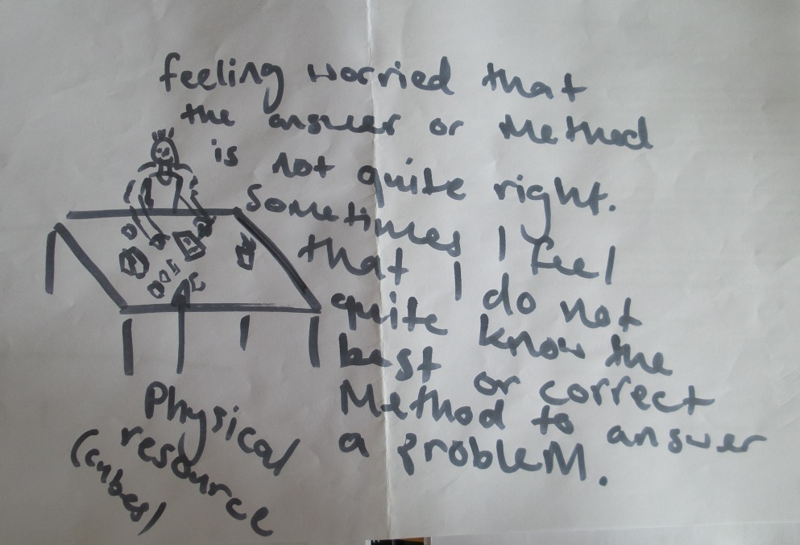
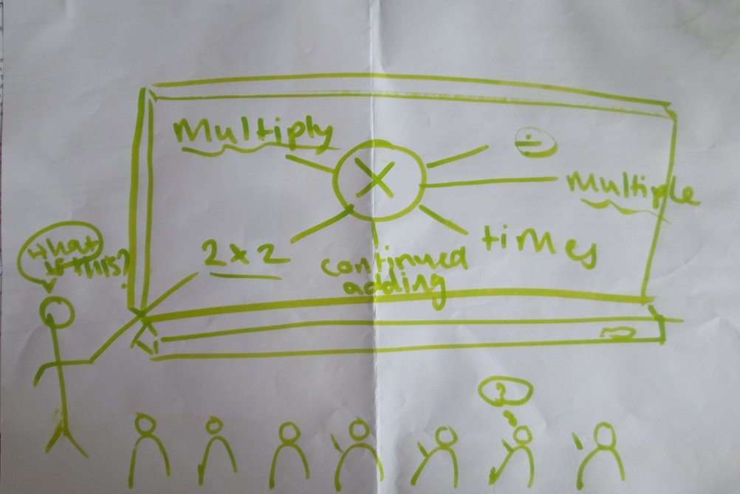
Findings Participant 3
Before
After

Slide 11
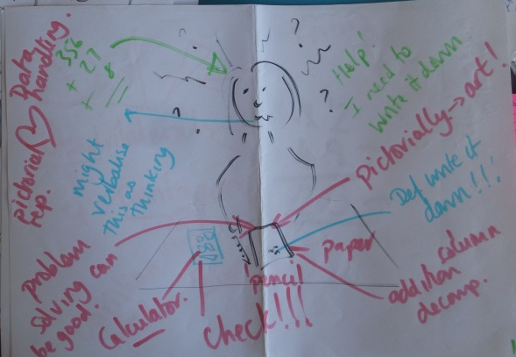
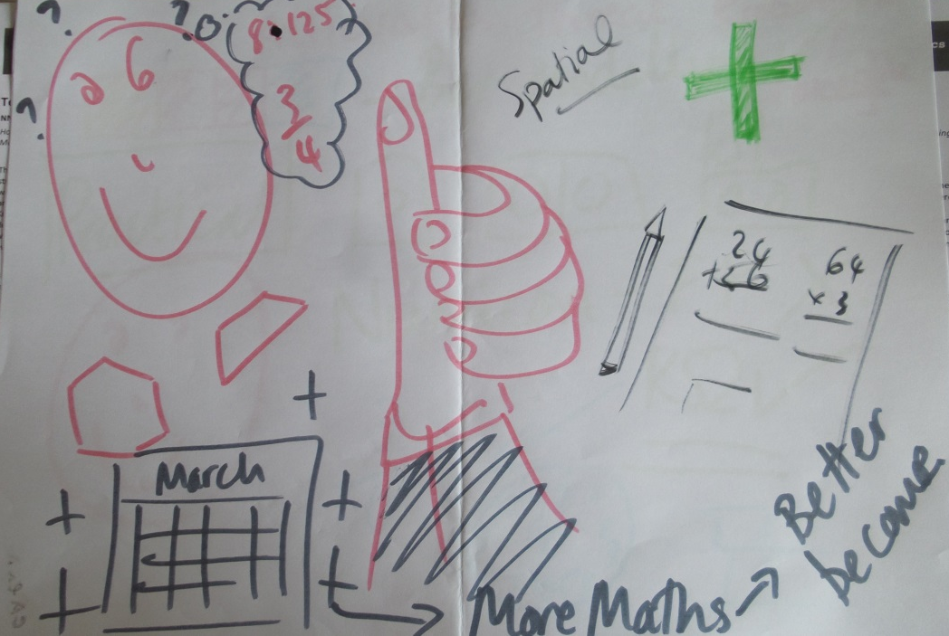
Findings Participant 2
Before
After

Slide 12
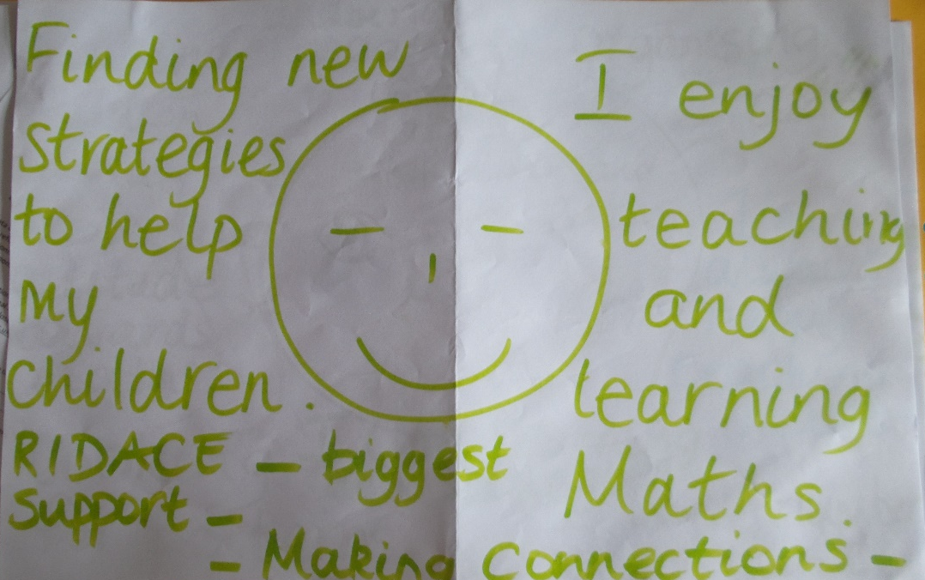
Findings Participant 1
Before
After

Slide 13

Conclusion & Limitations
“While more research is needed to determine when, how and for whom such an approach might be effective, it seems to be possible to reduce teacher MA using relatively modest, but carefully designed, interventions” (Cosgrove, 2021).

Slide 14
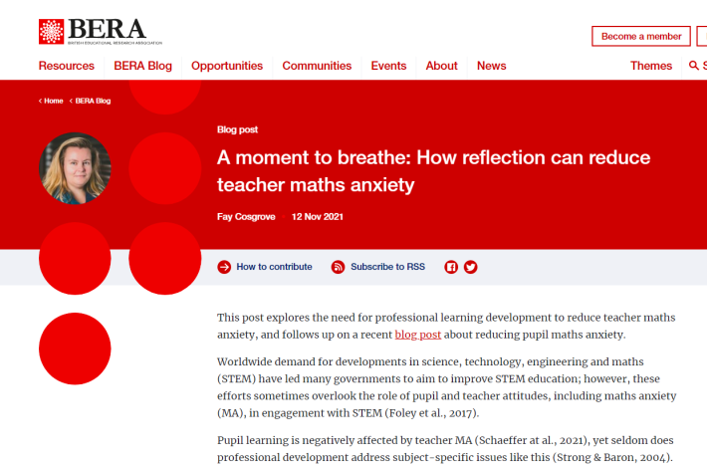
Proceedings & Blog
Reducing mathematics anxiety in primary school teachers through collaborative reflection using the knowledge quartet. https://bsrlm.org.uk/wp-content/uploads/2018/10/BSRLM-CP-38-2-05.pdf
Blog Post: https://www.bera.ac.uk/blog/a-moment-to-breathe-how-reflection-can-reduce-teacher-maths-anxiety

Slide 15
References
Beilock, S.L., Gunderson, E.A., Ramirez, G. and Levine, S.C. 2010. Female teachers’ math anxiety affects girls’ math achievement. Proceedings of the National Academy of Sciences, 107(5), pp.1860-1863.
Hopko, D.R., Mahadevan, R., Bare, R.L. & Hunt, M.K. 2003. The abbreviated math anxiety scale (AMAS) construction, validity, and reliability. Assessment, 10(2), pp.178-182.
Ohio State University,. 2017. Bandura’s Instrument: Teacher Self-efficacy Scale. (Online) Available at https://cpb-us-w2.wpmucdn.com/u.osu.edu/dist/2/5604/files/2014/09/Bandura-Instr-1sdm5sg.pdf
Rushton, S.J., Hadley, K.M. & Stewart, P.W., 2016. Mathematics Fluency and Teaching Self-efficacy of Teacher Candidates. Journal of the International Society for Teacher Education, 20(2).
Schaeffer, M.W., Rozek, C.S., Maloney, E.A., Berkowitz, T., Levine, S.C. and Beilock, S.L. 2021. Elementary school teachers' math anxiety and students' math learning: A large‐scale replication. Developmental science, 24(4), p.e13080.

Slide 16
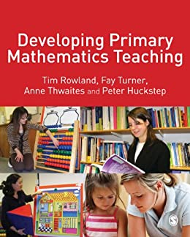
The Knowledge Quartet: Rowland et al (2005)
Book: Rowland, T. (2009). Developing primary mathematics teaching: Reflecting on practice with the knowledge quartet (Vol. 1). Sage.
Website: http://www.knowledgequartet.org

Slide 17
In the beginning ... Lee Shulman (1987)
Generic Knowledge
Knowledge of pedagogy, learners, educational contexts, educational purposes and values
Content Knowledge (‘The Missing Paradigm’)
subject matter knowledge (SMK) – product and process;
pedagogical content knowledge (PCK) - includes forms of representation of concepts, useful analogies, examples, demonstrations;
curriculum knowledge - materials and programmes.

Slide 18
Motivation for the KQ
Question: How can teacher educators and school-based mentors be assisted in giving more attention to mathematical content?

Slide 19



Using a Grounded Theory Approach
Began in 2002 and continues to present
Team of 5 researchers
Video 24 lessons taught by 12 trainee primary teachers on final practicum placement.
Focus on the teacher’s mathematics content knowledge (not just general pedagogical issues).

Slide 20
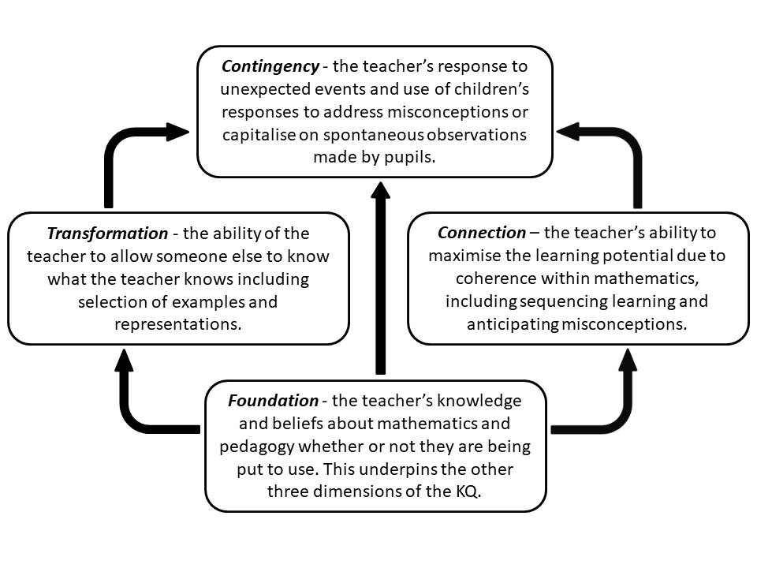
4 Dimensions

Slide 21
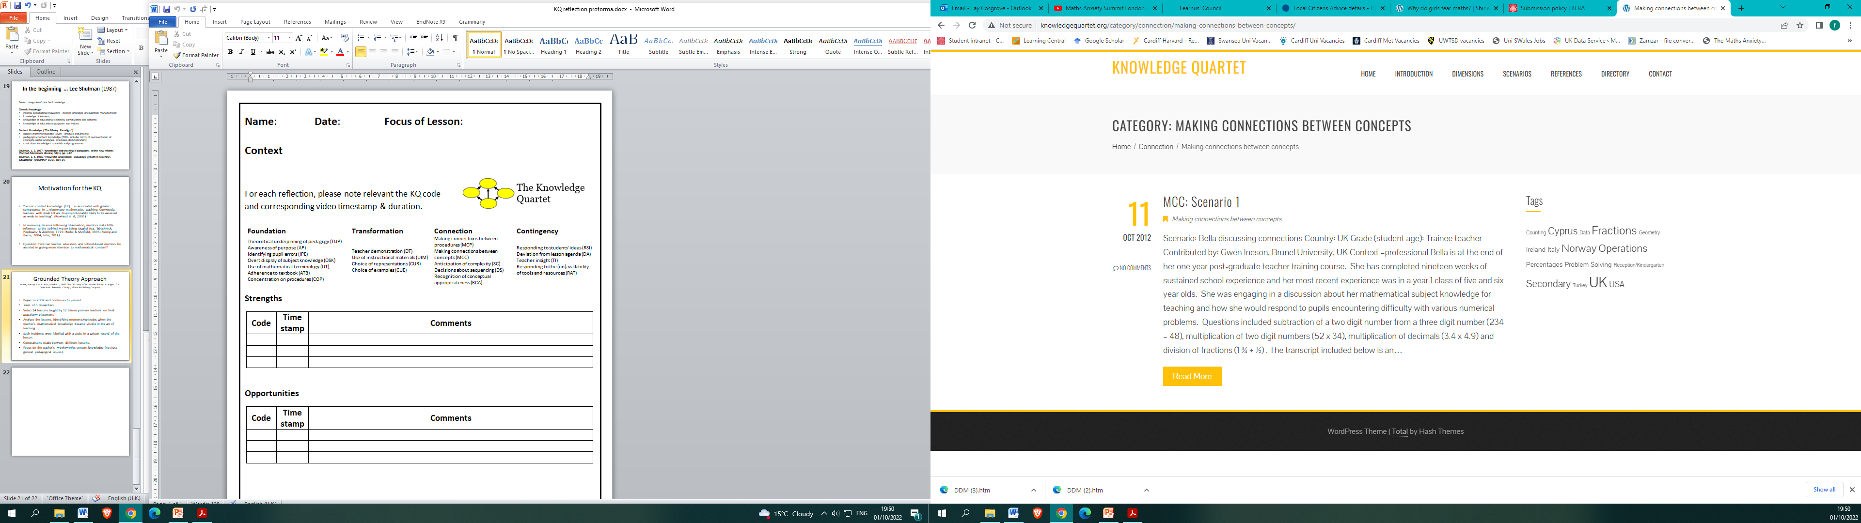
20 Codes

Slide 23

Tips
KQ is designed to be used to reflect on maths.
Video yourself (don’t work from memory).
Select short critical incidents (use a timecode).
Choose your own focus, don’t let a mentor dictate it to you.
Discuss it/review the incident with a trusted mentor or peer.

Slide 24
“… in observing and commenting on someone else teaching, the supportive observer stands to learn as much, or more, as the one being observed.” (Rowland et al, 2009)

Slide 25
References
Glaser, Barney G & Strauss, Anselm L., 1967. The Discovery of Grounded Theory: Strategies for Qualitative Research, Chicago, Aldine Publishing Company
Rowland, T. (2009). Developing primary mathematics teaching: Reflecting on practice with the knowledge quartet (Vol. 1). Sage.
Shulman, L. S. 1986. ‘Those who understand: knowledge growth in teaching’. Educational Researcher 15(2), pp 4-14.
Shulman, L. S. 1987. ‘Knowledge and teaching: Foundations of the new reform.’ Harvard Educational Review, 57(1), pp. 1-22

